Slide 1
Private Schools Interscholastic Association, Inc. (PSIA)
“Inspiring Student Achievement Through Academic Competition”
Fall Workshop 2022

Slide 2
Objectives of this Workshop
New Website
Review PSIA Organization of Events and the Conflict Pattern
Contest Rule Changes, Curriculum Add-ons, & More

Slide 3
Executive Director
Doug Ray
doug@academicmeet.com
Cell/Text: 512-797-2158
PO Box 1225
Lampasas, Tx 76550

Slide 4
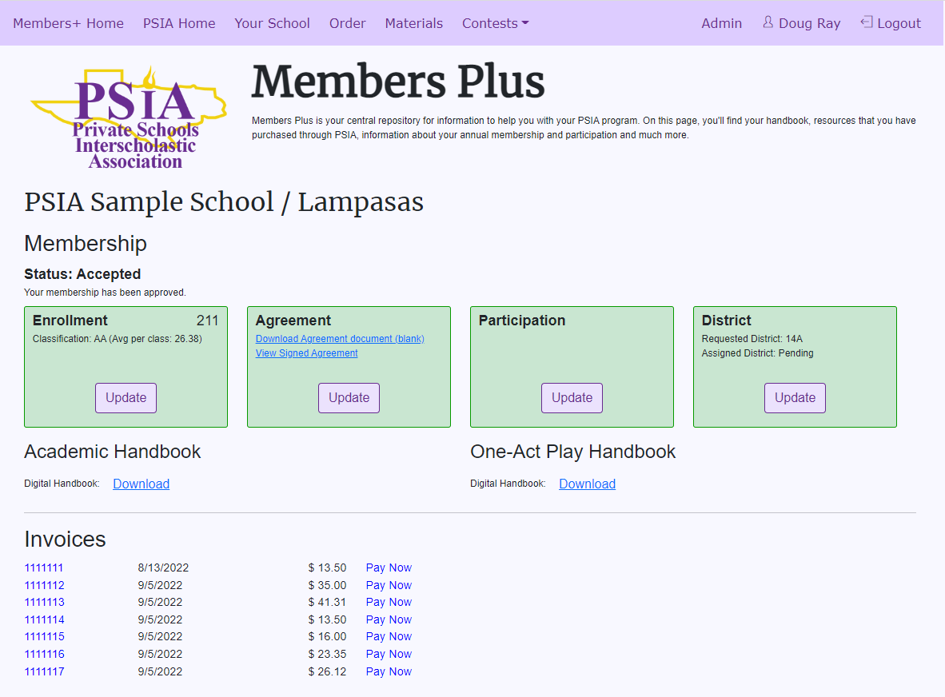
New website

Slide 5
Menu Bar
Update School Information
Online Order Form
Materials Purchased
Contest Information
Status
Change Enrollment / Participation
Download Digital Handbooks
Invoices

Slide 6
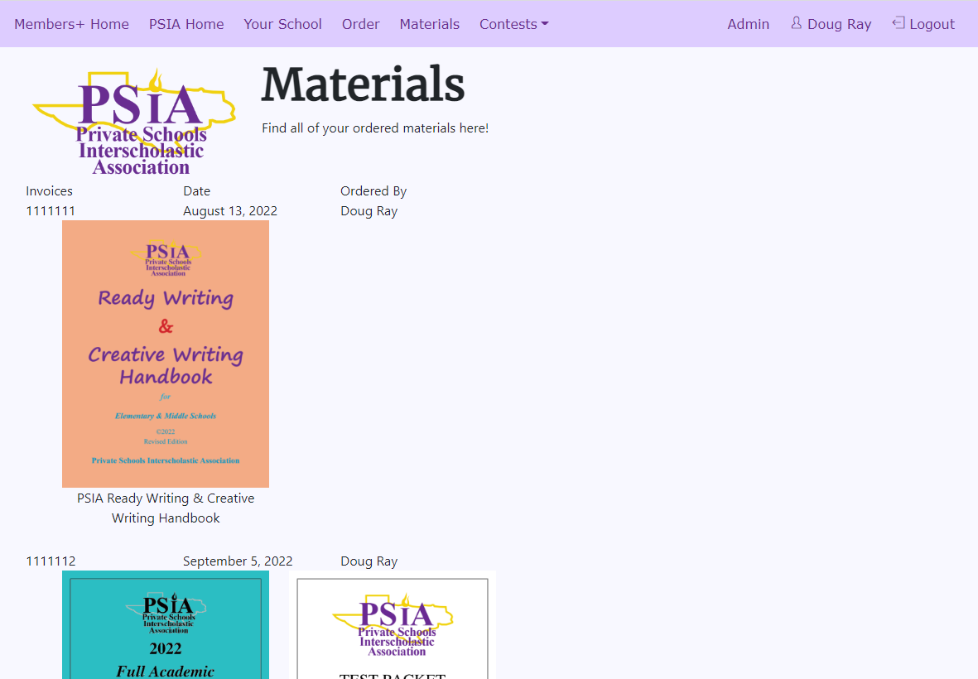

Slide 7
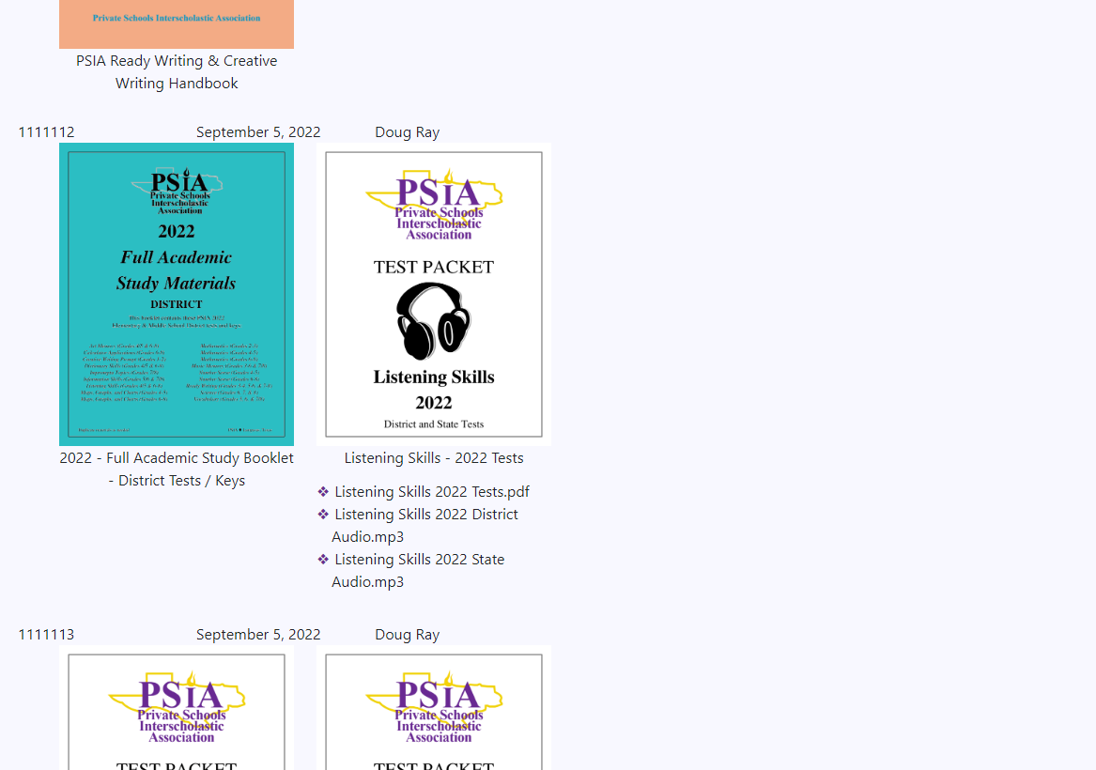
New Items:
Full Academic Study Materials
by Meet and Year
Individual Contest Packets
Two Tests from Single Year

Slide 8
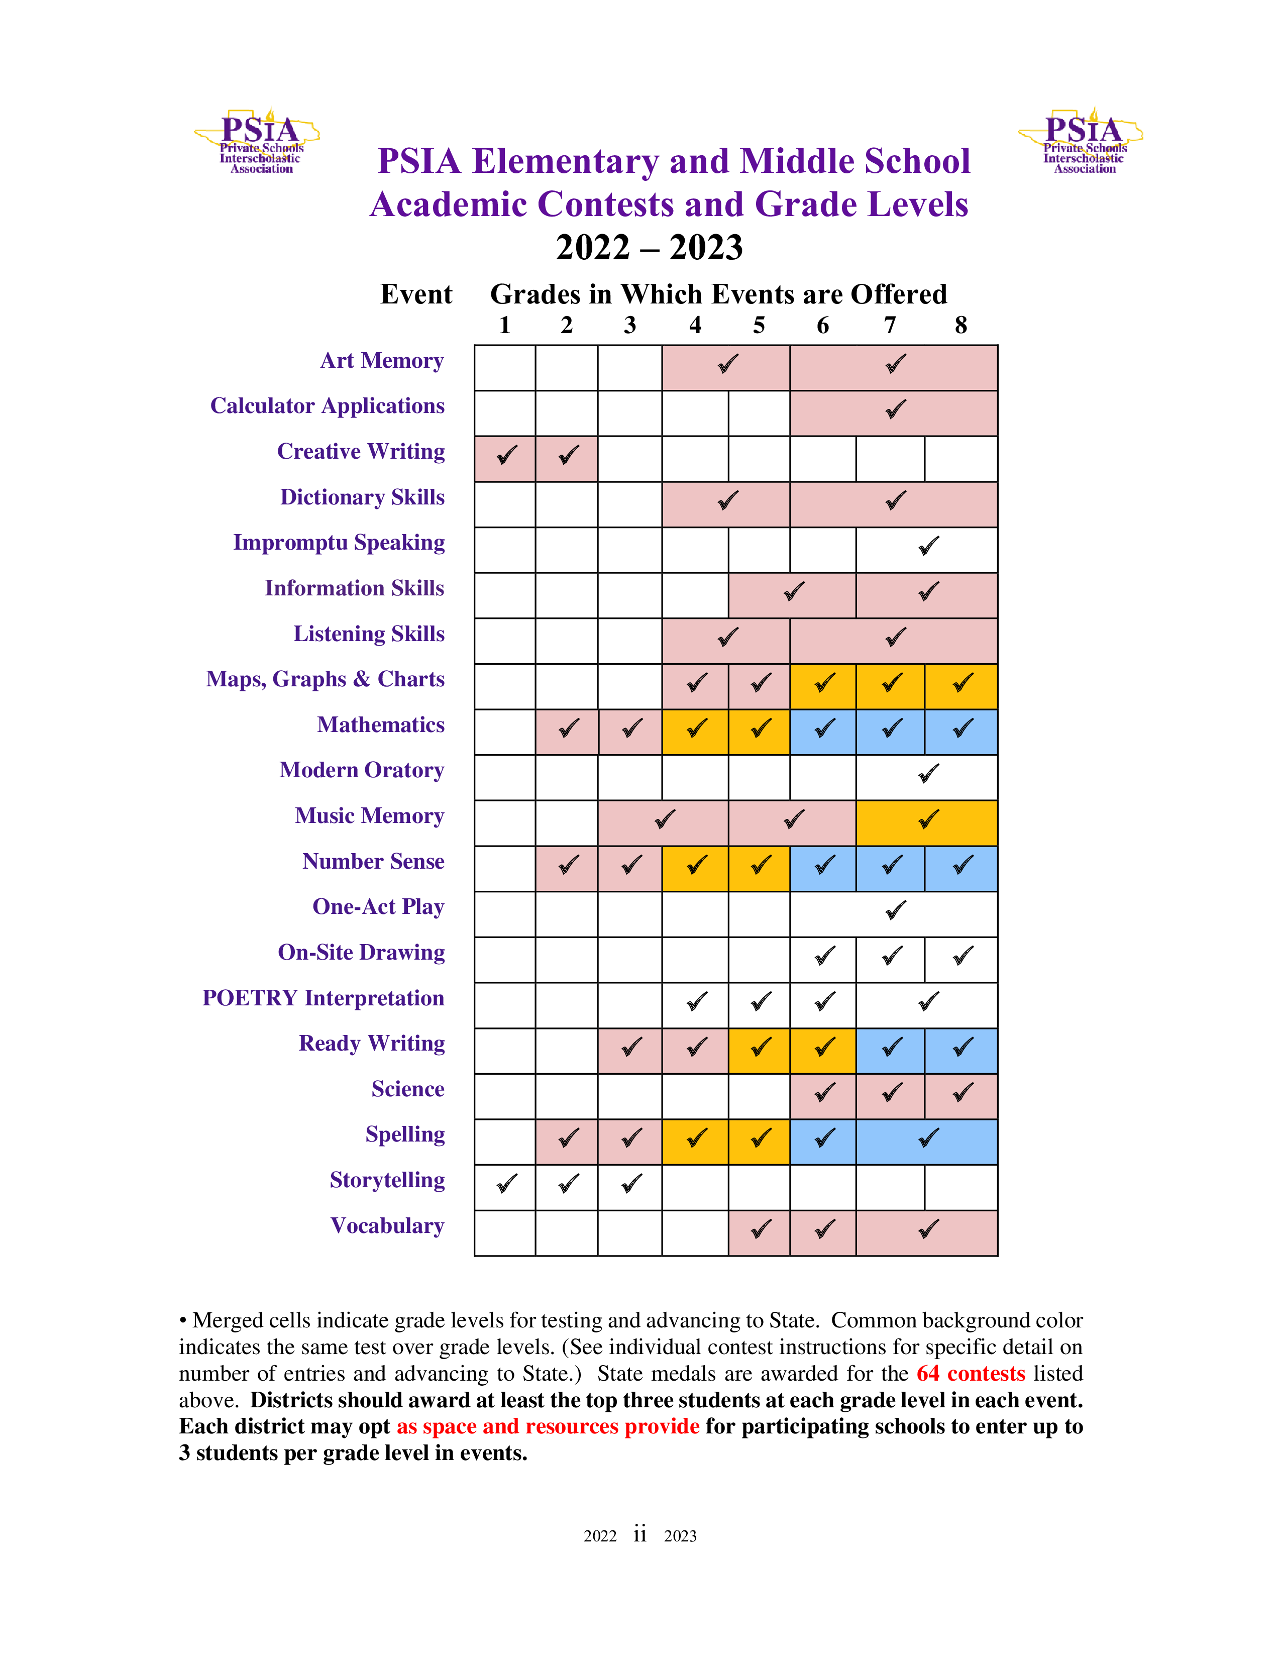
Events
Number Sense 2 & 3
Regular Contest
Two contestants in each grade advance to state
Science 4-5
PILOT
No Advancing To State
✓ ✓

Slide 9
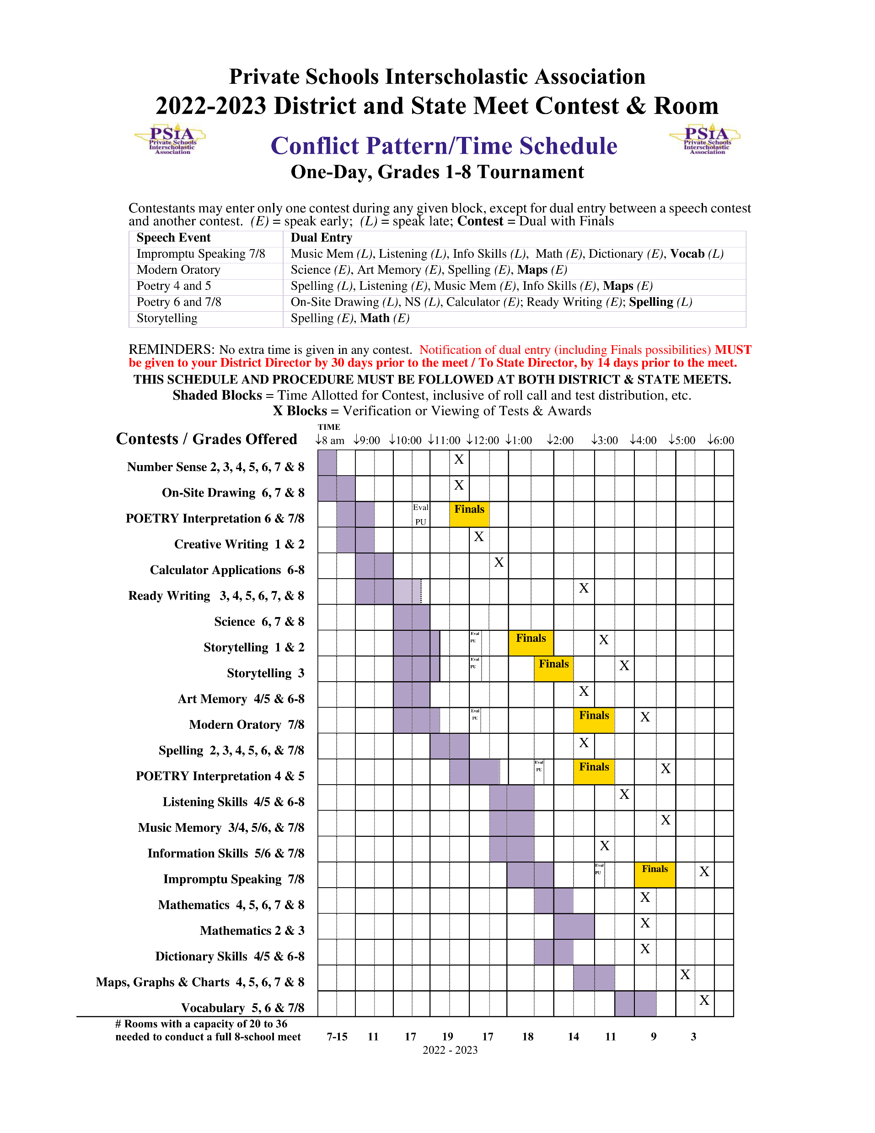
Conflict Pattern

Slide 11
Merriam-Webster Dictionary-2018+
225,000 definitions
165,000 entries
42,000 usage examples
38,000 etymologies
12,000 geographical names
7,500 idioms and phrases
6,000 biographical names
700 pictorial illustrations
700 foreign words and phrases
Can tab and write?
✓
Includes free online subscription

Slide 12
Maps, Graphs & Charts
Nystrom Desk Atlas (2018 or newer edition) will be the only “official” resource for this contest. HOWEVER, any world atlas may be used in contest. A 2018 edition is currently available.
• www.socialstudies.com
✗
Can tab and write?

Slide 13
2022-2023 Modern Oratory Topics
1. Can artificial intelligence come alive?
2. Will electric cars replace gas-powered cars in the U.S.?
3. Title IX: 50 years later — have women gained?
4. Should community service be a requirement for high school graduation?
5. Does the United States have a responsibility to aid in resolving conflicts abroad?
Topics are posted on the PSIA website and in the PSIA Academic Handbook.

Slide 14
Cautions for Interpretative Reading:
AVOID touching hair, face, or clothing – Touching anything on one’s body MAY be regarded as use of a PROP and result in a deduction in rank.
AVOID over-the-top dramatization, which could make the “interpretation” seem more like a DRAMATIC Monologue. Deduction in rank may result, BUT subjectivity is not objective.
DO gesture as a “natural” outgrowth of the words being read. (Interpretation of “natural” varies.)
DO use your notebook and give “artful” glances to the pages in it. Pretend to read most of the time.
DO voice changes, inflections, and volume variation.

Slide 15
Objective vs. subjective
All writing and speech contests are SUBJECTIVE.
Percentages on evaluations are guidelines for the amount of weight to give to each aspect of your SUBJECTIVE assessment. NOT SCORES!
No Ties in subjective contests.

Slide 16
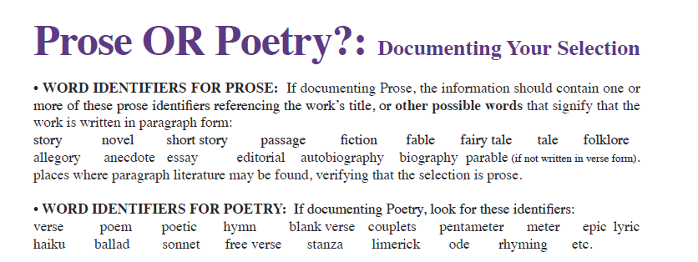
Poetry or Prose Interpretation
POETRY

Slide 17
Poetry or Prose Interpretation
Digital Documentation

Slide 18
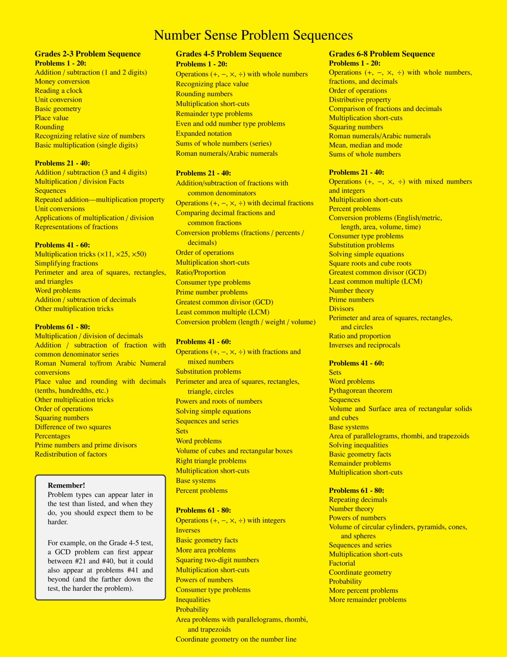
Number sense

Slide 19
Number sense

Slide 20
Number sense – SPECIAL TOPICS MIDDLE SCHOOL TEST
Multiplication by 37
Sum of Reciprocals
Partial Fraction Decomposition
Remainders in Different Bases
See Handout

Slide 21
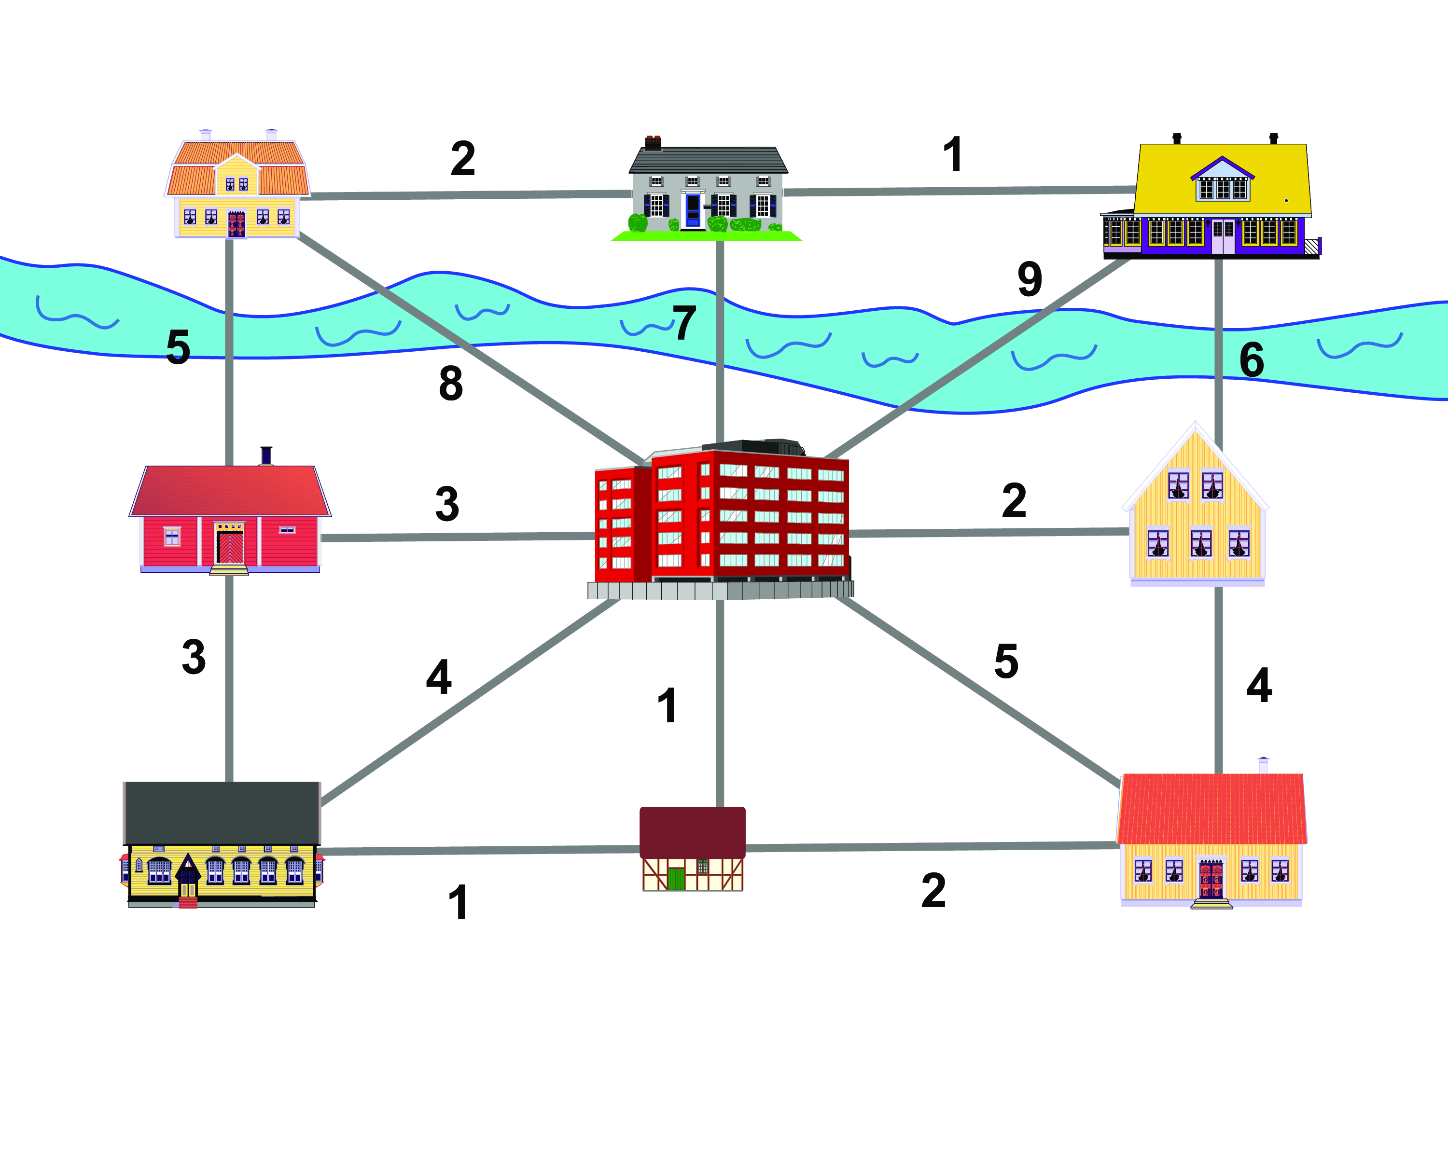
Mathematics – Special topic graph theory

Slide 22
Mathematics – Special topic graph theory
The full Graph Theory handout is in your Workshop folder.
Also found under Resources on www.academicmeet.com.

Slide 23
Mathematics – Additional Topics
Basic Statistics
Averages (Means), Medians, Modes (bimodal), Range
Box and Whiskers plot
Meaningful Interpretation of Stats

Slide 24
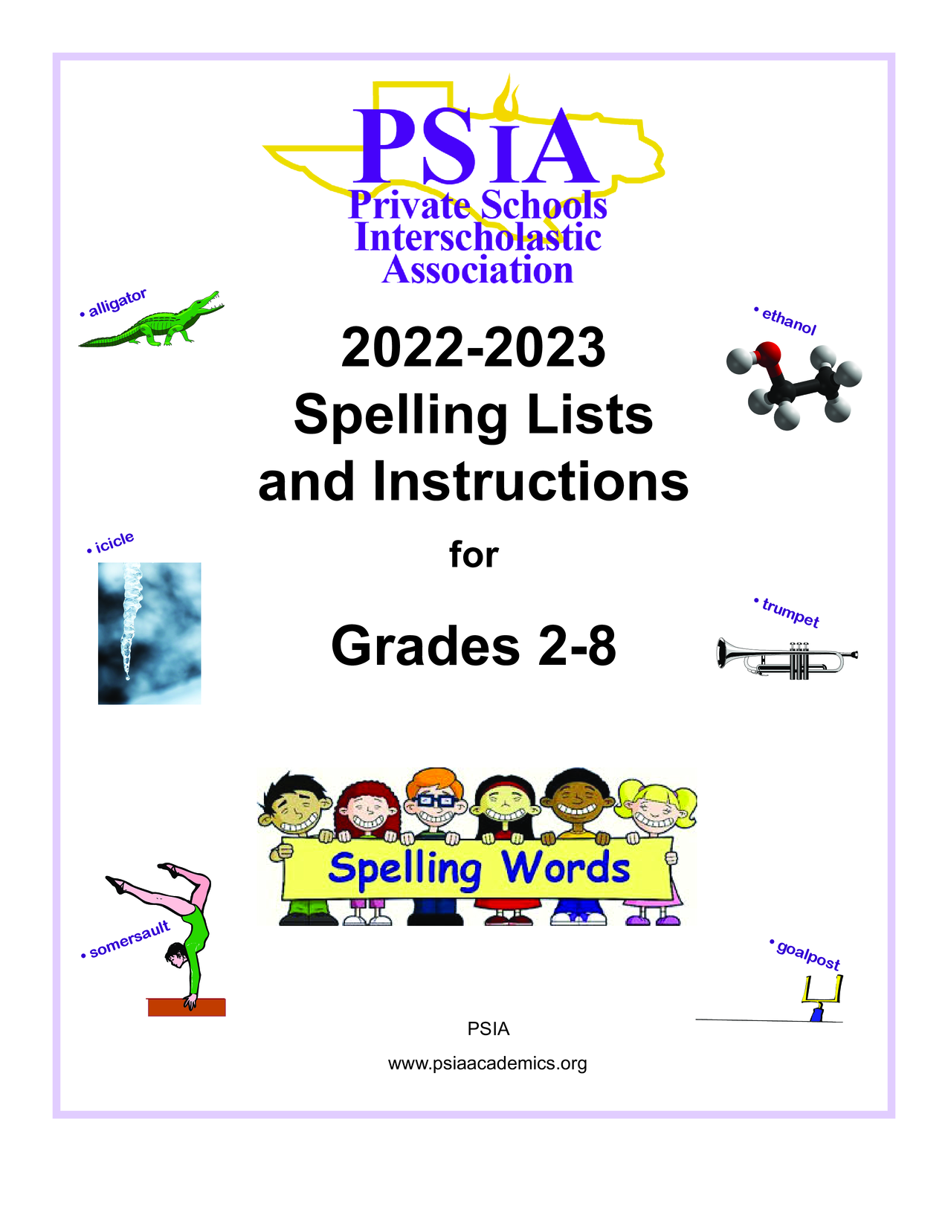
Spelling
2022-2023 Spelling Lists
Available On Members Plus
Lists And Instructions Guide
Available for purchase
600 words (grades 2-3)
800 words (grades 4-5)
900 words (grades 6-8)

Slide 25
Spelling
Test Words (outside)
Gr. 2-3: 50 words (13)
Gr. 4-5: 75 words (19)
Gr. 6-8: 100 words (25)
Regular Words = +5
Outside Words = +7

Slide 26
Spelling
Watch out for derivatives (4-5 and 6-8)
List Word | Derivative
federate | federation
overthrow | overthrew
ecology | ecological
valid | validity
organize | organizer
affirmative | affirmation
improvise | improvising
thesis | theses
anecdote | anecdotal
philosophy | philosophical
List Word | Derivative
biography | autobiography
barometer | barometric
infatuate | infatuation
oppress | oppression
sophistication | sophisticated
hierarchy | hierarchical
timidity | timid
demographic | demographer
miscellaneous | miscellany
serendipity | serendipitous

Slide 27
Spelling

Slide 28
Spelling

Slide 29
Spelling
Delivery of the words via computer audio file (.mp3) to be played in the classroom

Slide 30
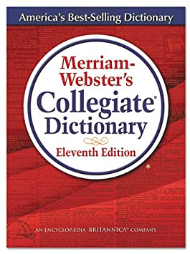
Spelling
Merriam-Webster’s Collegiate Dictionary
11th ed.
2018+

Slide 31
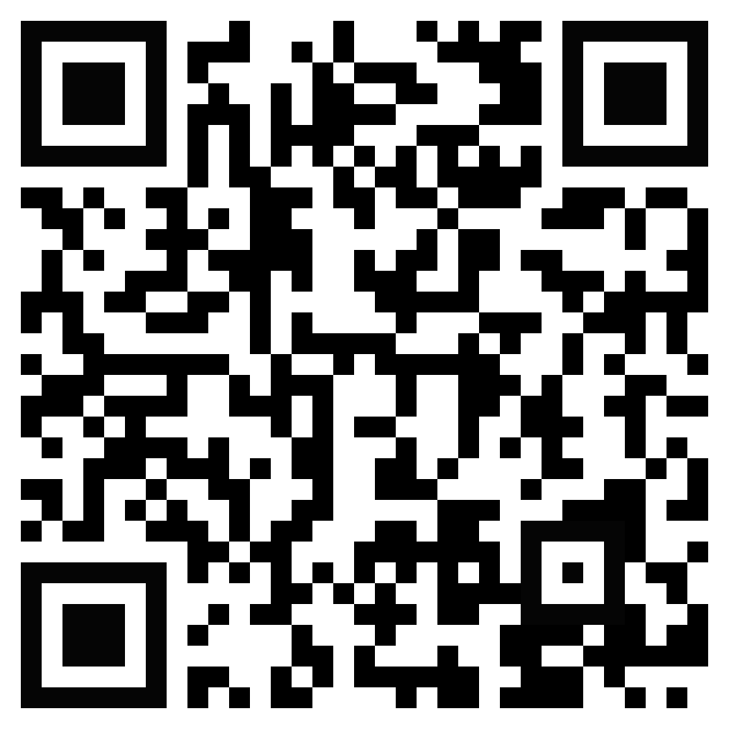
Vocabulary
Merriam-Webster’s Collegiate Dictionary
11th ed.
2018+
300 words found in Handbook
Quizlet

Slide 32
Vocabulary daily
3 new words Mon-Thurs
3 question quiz on Fridays
Starts October 3rd
Runs through mid-February

Slide 33
Dictionary Skills
Merriam-Webster’s Collegiate Dictionary
11th ed.
2018+

Slide 34
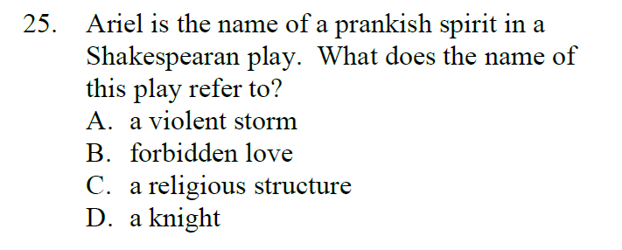
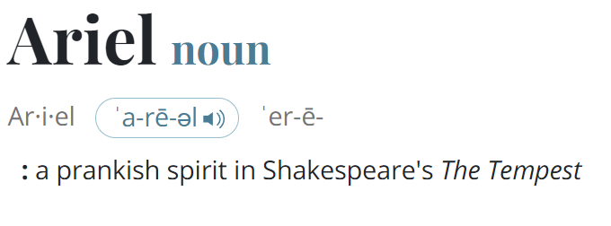
Dictionary Skills
Teaching Tip: Be wary of “double searches”

Slide 35
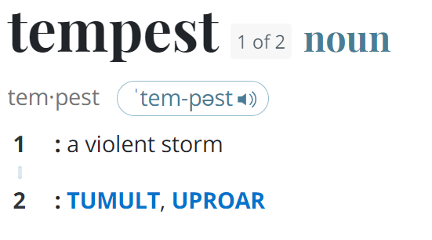
Dictionary Skills
Teaching Tip: Be wary of “double searches”

Slide 36
Information Skills
6 categories / 4 questions each = 24 questions
30 minutes
Students use their internet-connected device to answer questions

Slide 37
Information Skills
Rule Change:
Common nouns must not be capitalized
Proper nouns must be capitalized
Scoring:
Completely Correct: +5 points
Correct answer with errors in capitalization, spelling, or punctuation: +3 points
Incorrect answer: No points awarded or deducted

Slide 38
Information Skills
Pablo Picasso
+5
Picasso
+5
pablo picasso
+3
Dali
V

Slide 39
Information Skills
Rule Change:
Hot Spot allowed

Slide 40
Art Memory
Reduced number of paintings to 30
Images can be found on Members Plus
Same images as last year
Art Smart from UIL

Slide 41
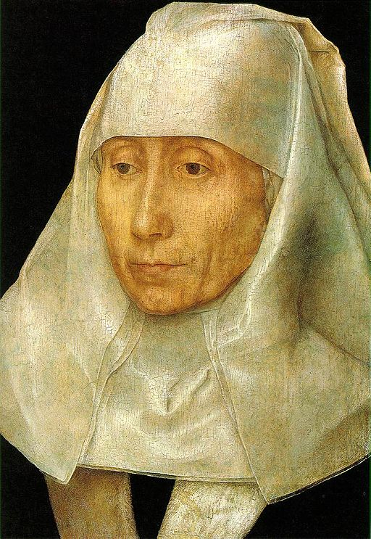
Portrait of an Old Woman
Memling

Slide 42
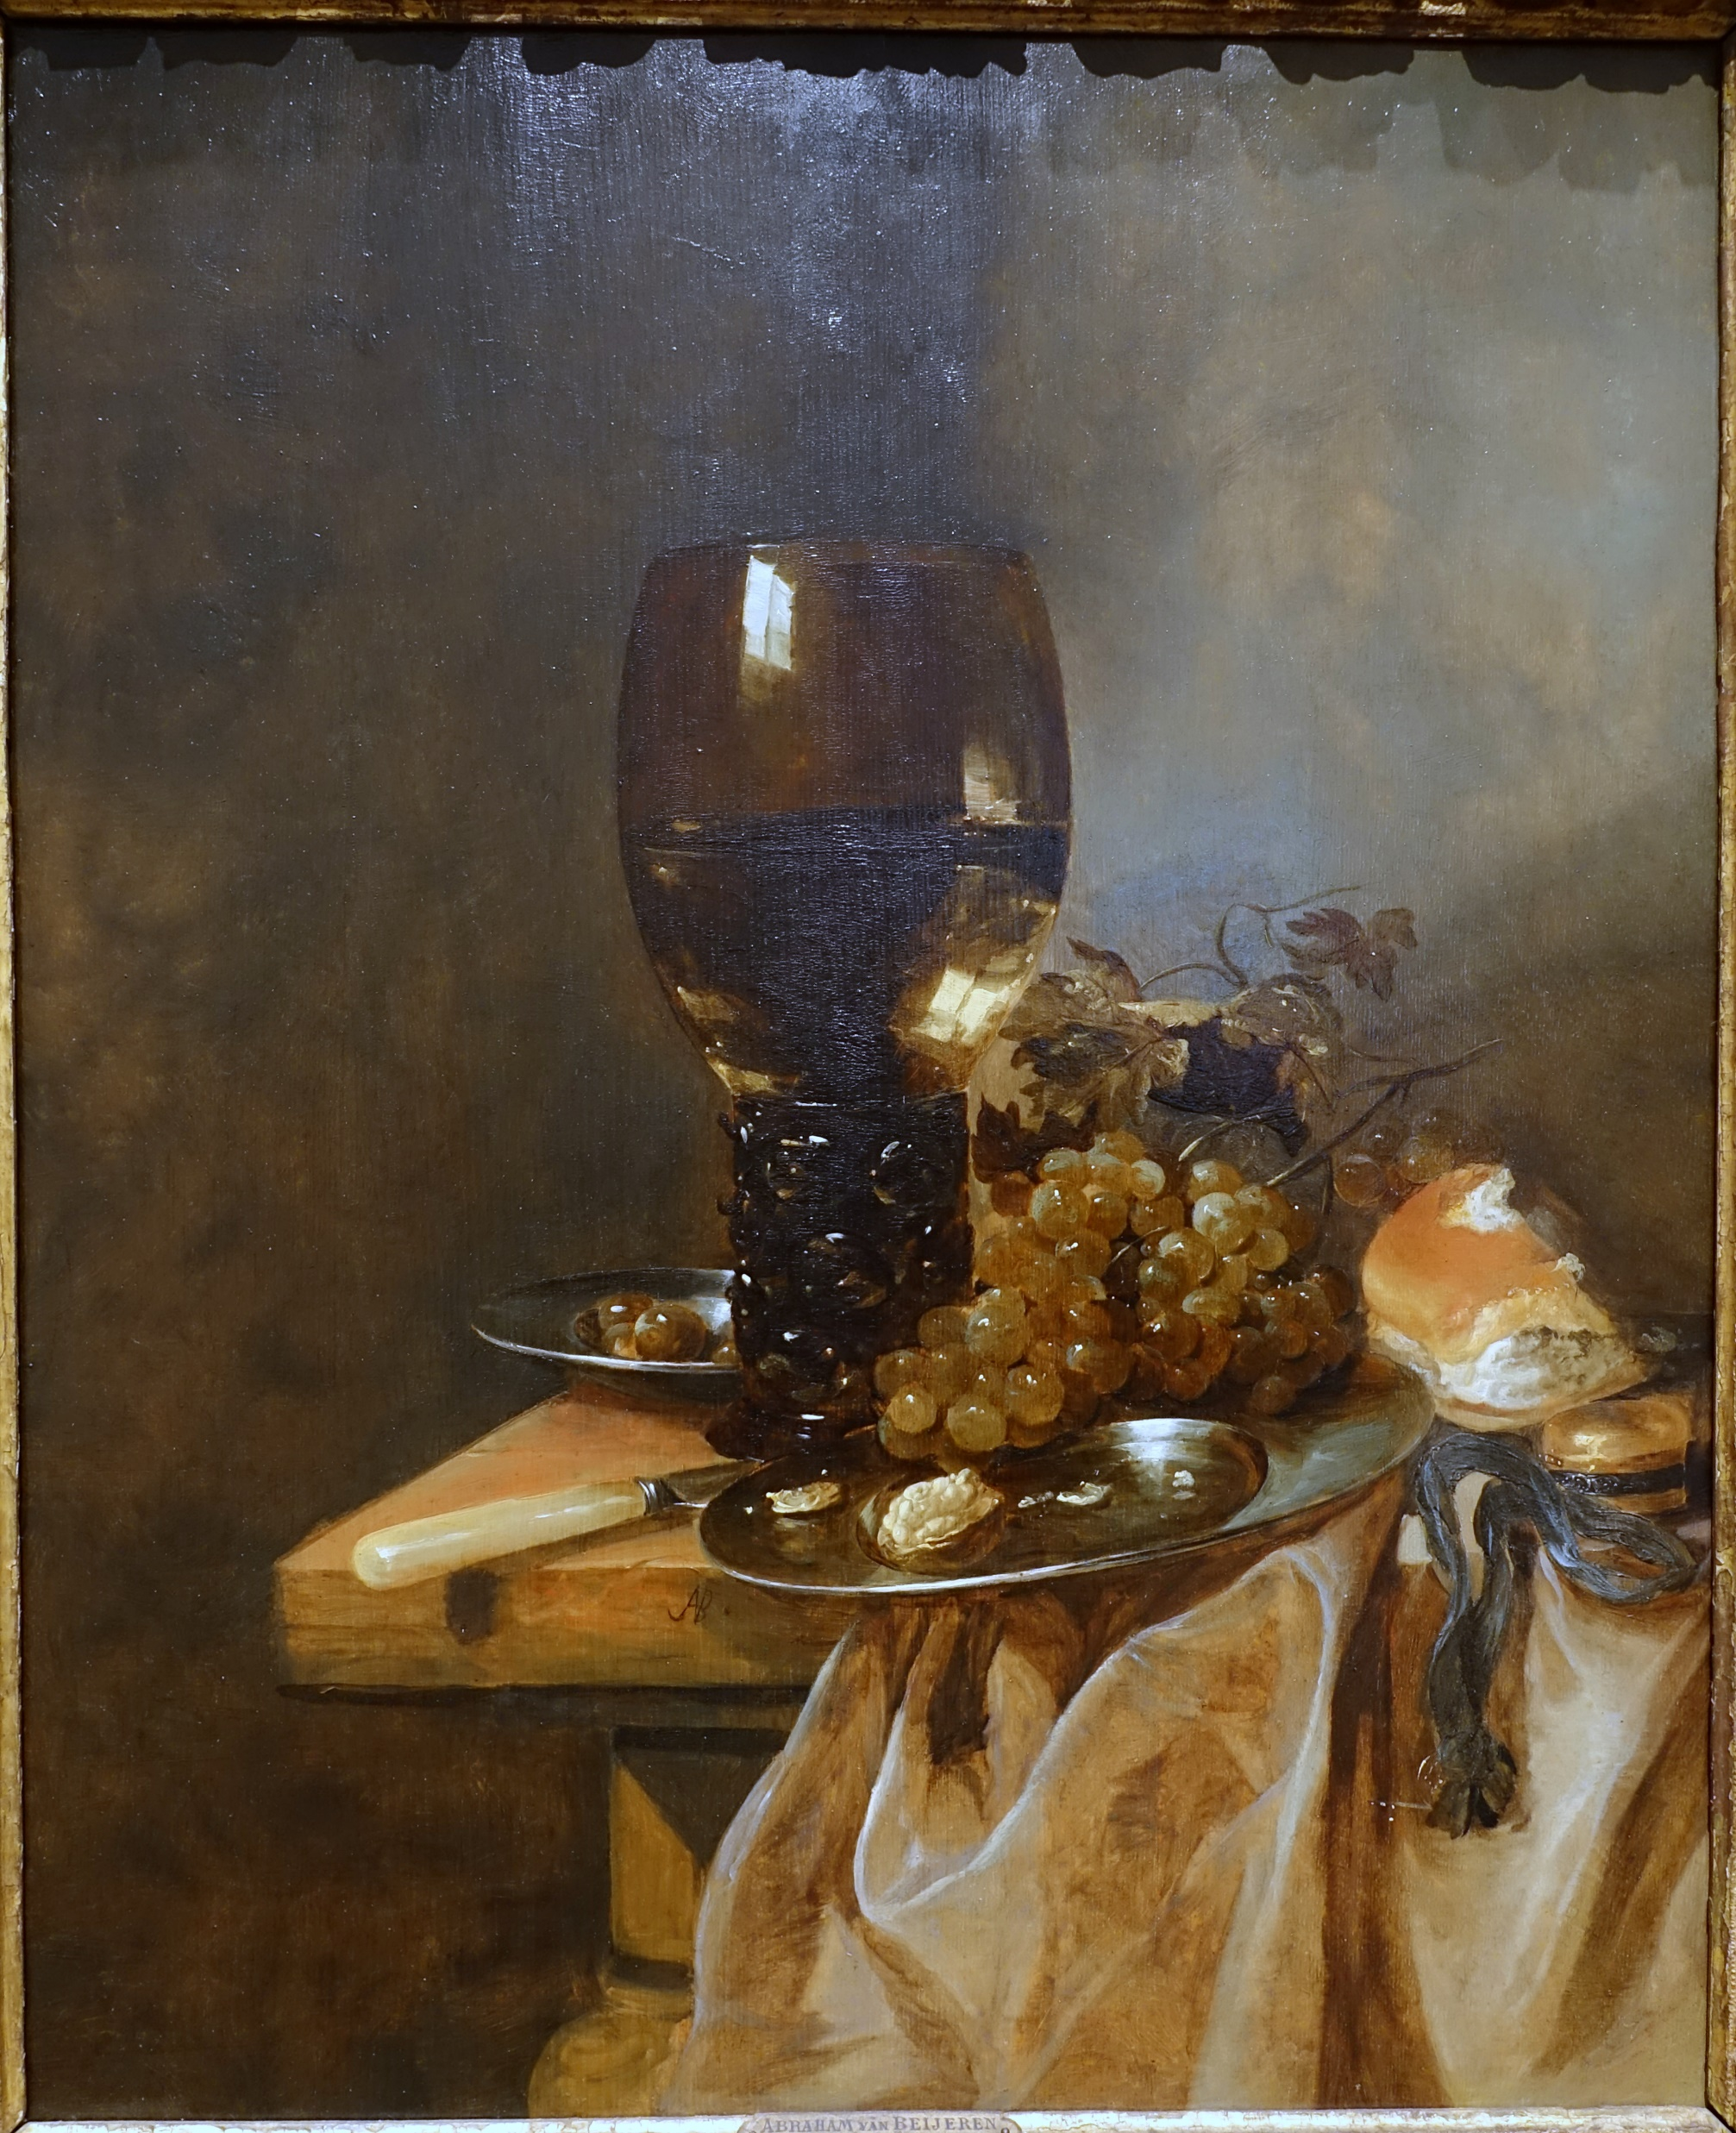
A Roemer with Grapes, a Pewter Plate, and a Roll
Van Beyeren

Slide 43
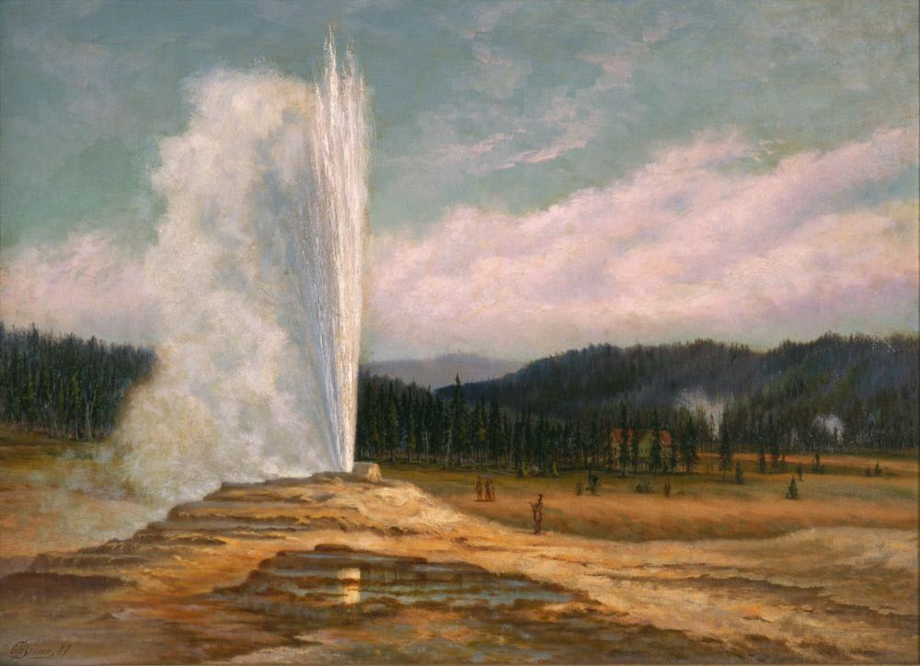
Old Faithful Geyser, Yellowstone National Park
Brown

Slide 44
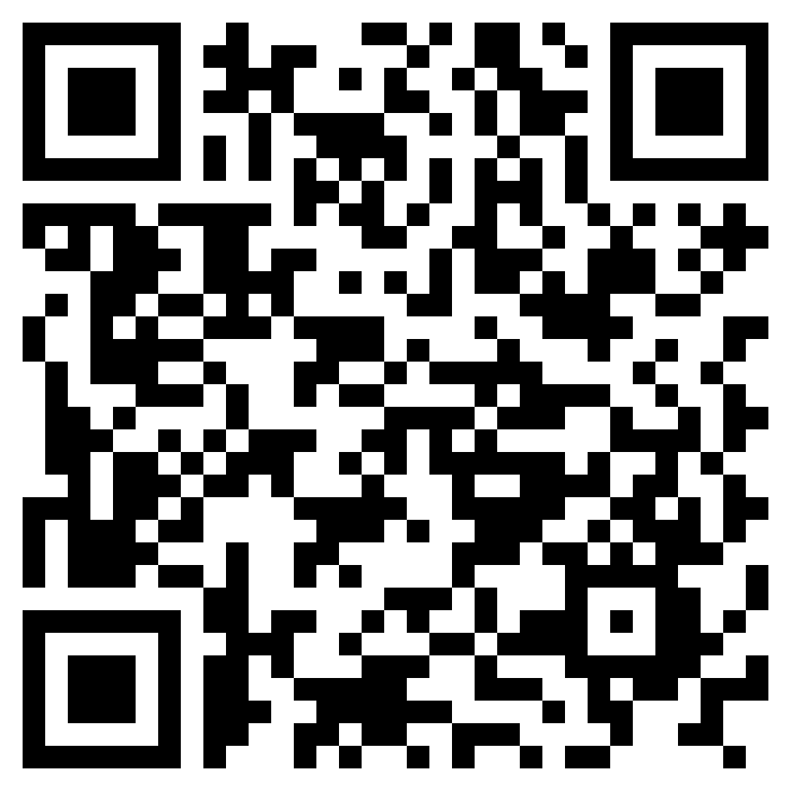
Music Memory
Spotify Link:
https://tinyurl.com/psiamm2023

Slide 45
Celebrating 26 Years
Inspiring Student Achievement
Through Academic Competition

